Slide 1
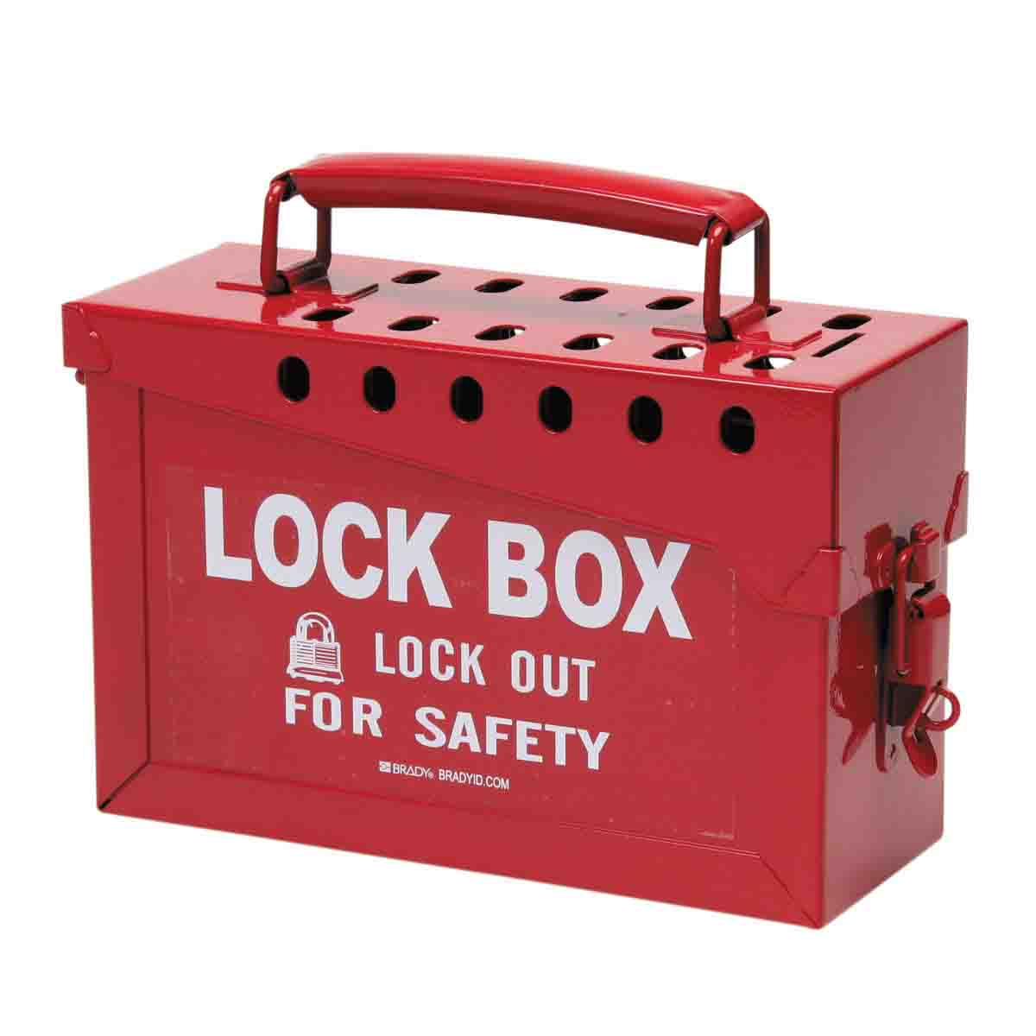
PowerPoint for finding the Lock Box 2 and its Key

Slide 2
Location to Lock Box 2
Question 1:
Is it on the floor?
YES
NO

Slide 3
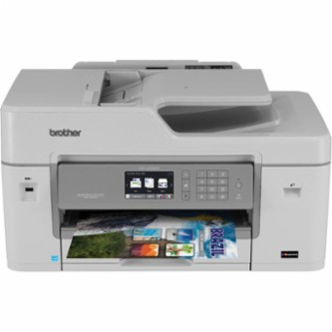
CORRECT
Located on the floor! Next question…
Is it located by the printer?
YES
NO

Slide 4
You are Wrong
You need to start at the beginning.
Click me to go back.

Slide 5
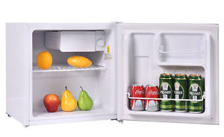
CORRECT
Located on the floor, but not by the printer.
Is it located near the refrigerator/ media door?
YES
NO

Slide 6
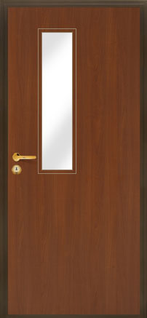
CORRECT
So it is on the floor, not near the printers and it is not near the fridge. Is it near the classroom door?
YES
NO

Slide 7
CORRECT
You are very warm now and getting closer…
It is on the floor, not near printer, refrigerator or classroom door….
Is it near Mrs. Guzinski’s desk?
YES
NO

Slide 8
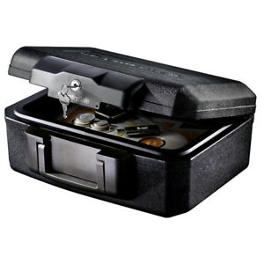
NOW YOU KNOW
That the box is under Mrs. G’s desk.
Congratulations!
You now know where the lock box is located!
SO GO FIND IT….

